Slide 1
TO-DO LIST
By team csm-B

Slide 2
AGENDA
Prioritization
​Time management
Organization
​Productivity
Stress reduction

Slide 3
Tecnologies used
.Flask is used to provide a server with connect Frontend and Backend
.Html is used for creating webpages
.CSS is used design webpage

Slide 4
Introduction
A to-do list is a simple but powerful tool that can help you manage your tasks, time, and productivity. At its core, a to-do list is a list of tasks or activities that you need to complete. By making a list of what needs to be done, you can easily prioritize your tasks, manage your time effectively, and reduce the feeling of being overwhelmed.

Slide 5
SUMMARY
*In summary, a to-do list is a powerful tool for managing tasks, time, and productivity. It is a list of tasks or activities that need to be completed, and can be used for personal or professional purposes. By breaking down tasks into smaller, actionable steps and prioritizing them based on importance and urgency, a to-do list can help reduce stress, improve organization, and hold you accountable for completing tasks.

Slide 6
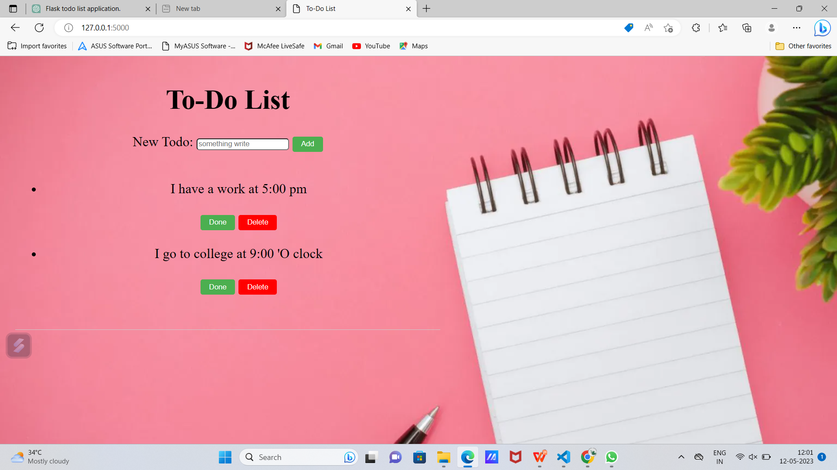
output of this project

Slide 7
THANK YOU

